Slide 1
‘Everyone has a right to feel safe: speak up about the unspeakable!’
How to spot signs of adult abuse and how to report it if you are concerned
Information for Adults at Risk, carers, family members and members of the public
Information and images have been compiled from various websites including NHS, SCIE, Action on Elder Abuse, Community Care and Calderdale Safeguarding Adults Board

Slide 2
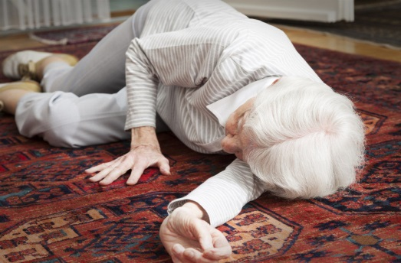
Types of abuse
Can anybody name the different types of adult abuse?
Emotional/Psychological
Physical
Domestic Abuse
Neglect or Acts of Omission
Sexual
Discriminatory
Organisational
Financial
Self-Neglect
Modern Day Slavery
Forced Marriage and Honour Based Violence

Slide 3
Physical e.g. Hitting, pushing, locking them in a room, giving the wrong dose or wrong medication, forcible feeding
Sexual
e.g. Rape or Sexual assault (forcing someone to have sex or take part in sexual activities without their consent), touching, making someone watch sexual videos
Emotional/Psychological
e.g. Humiliating, blaming, harassing, bullying, isolating someone
Discriminatory
Being treated badly because they are different (race, gender, age and disability)
Domestic Abuse
Any incident of controlling, coercive, threatening behaviour, violence or any type of abuse between those who have been intimate partners or family members.
Financial
e.g. Stealing (taking money/possessions without permission), putting pressure on someone to change their wills, property or inheritance
Notes:
Can anybody tell me what physical abuse can look like?
Can anybody tell me what emotional abuse is?

Slide 4
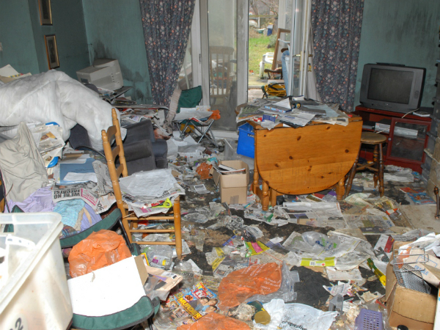
Self-Neglect
Self-neglect is when someone does not take care of themselves properly. This can put their safety, health and well-being in danger
Modern Day Slavery e.g. Trafficking someone (moving someone around the country/ across borders) to use for sex trade, free/cheap labour etc. Treating somebody like they are a slave
Neglect or acts of omission Neglect - someone says they are going to help someone by giving them care and support but they do not. E.g. not providing food, shelter, clothing and heating. Not administrating medication, not seeking medical advice. Acts of omission is when someone ignores situations when someone else is being neglected.
Organisational
Any type of abuse by an organisation e.g. neglect in a care home, neglect by a home care provider
Forced Marriage and Honour Based Violence Forced Marriage is when someone is forced into getting married against their will. This can be towards one or both of the people who are getting married. It is different to an arranged marriage. Honour Based Violence is a form of domestic abuse, and is when someone is punished for bringing ‘shame’ on their family. This can be physical abuse, sexual abuse, emotional abuse, or controlling behaviour.

Slide 5
Group Task
Get into groups
Discuss what you think the signs of abuse could be for at least 3 types of abuse
10 minutes
Notes:
Allocate each group 3 types of abuse

Slide 6
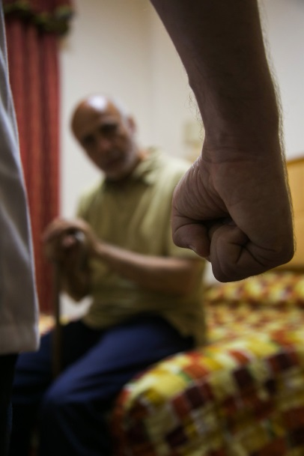
Possible Signs of Abuse
Physical e.g. Unexplained bruising, cuts, burns, signs of malnutrition, unexplained falls, failure to seek medical attention from GP/hospitals, withdrawn, scared of someone.
Sexual
e.g. Bruises to inner thighs, marks on neck, unusual difficulty in walking/sitting, unusual bleeding to genitals or anus, Sexual Transmitted Infections, fear of receiving personal care support
Financial
e.g. Missing personal possessions, unexplained withdrawal from bank accounts, unexplained lack of money if they are due there benefits/pension
Emotional/Psychological
e.g. Withdrawn or change in mood, Insomnia, Low self-esteem, A change of appetite, weight loss/gain
Domestic Abuse
e.g. Low self-esteem, bruising/cuts/broken bones, verbal abuse or humiliation in front of someone, isolation from family and friends
PLEASE NOTE:
These are some examples, but is a non-exhaustive list
Notes:
Who did what – compare each type with what the groups have come up with

Slide 7
Self-Neglect
e.g. When someone is looking after themselves, but has very poor hygiene and unkempt appearance, malnourished, hoarding in the property, living in squalid conditions, lack of food and heating, will not engage with social care or health services
Organisational
e.g. Poor record-keeping and missing documents, Unnecessary exposure during bathing or using the toilet, Lack of choice, being hungry or dehydrated, Lack of personal clothing and possessions for someone living in a care home.
Modern Day Slavery e.g. Appearing to be malnourished, unkempt or withdrawn, Living in dirty, cramped or overcrowded accommodation and or living and working at the same address, Lack of personal possessions or identification documents, Always wearing the same clothes, Fear of the Police.
Neglect or acts of omission e.g. If someone is supposed to receive support from someone else, but they have poor personal hygiene, pressure sores/ulcers, untreated injuries or medical problems, inadequate clothing, malnutrition or weight loss, poor living conditions, or the carer is refusing visitors to the home
Forced Marriage and Honour Based Violence e.g. The person is going on an extended holiday to the country of their origin, their siblings have been ‘married off’ and not returned home. Absence from education (college or university) or work, the person being accused for being ‘too westernised’, restrictions on leaving their house including being ‘escorted’ everywhere.
PLEASE NOTE:
These are some examples, but is a non-exhaustive list

Slide 8
Who is at risk of abuse?
An Adult at Risk is someone who is over the age of 18 years old and…
has care and support needs (e.g. Physical disability, Mental Health Issues, cannot see or hear, be elderly, or an unpaid carer looking after friends or family)
AND
may be experiencing or at risk of abuse or neglect
AND
is unable to protect themselves from abuse and neglect because of their care and support needs
For example: These adults may find it hard to keep themselves safe from abuse or neglect, and to get help if it happens.

Slide 9
Who can abuse?
A Partner/Spouse
Relative
A Carer
A Stranger
A Friend
A Neighbour
An organisation
Another service user
A Volunteer
Abuse can be committed by anyone!
Notes:
Does anybody know?

Slide 10
Where can abuse occur?
At home
On the street
In a hospital
In a pub or club
On the bus or train
In a care home
Abuse can happen anywhere!

Slide 11
Did you know abuse is a Safeguarding issue?
What does safeguarding mean?
Safeguarding means protecting an adult’s right to live in safety, free from abuse and neglect.
Notes:
Can anybody tell me what safeguarding means?

Slide 12
How to report abuse
Tell someone you trust. They should then report the concerns to…
Gateway to Care - 01422 393000 (Mon – Fri office hours)
Emergency Duty Team - 01422 288000 (Evenings and Weekends)
If it is an emergency and someone's life is at risk - police – 999
If a crime has been committed, but it is not life threatening - police non-emergency line - 101
They need to do this as soon as possible and ensure the Adult at Risk is safe!
You can also self-refer if you don’t feel you have anyone who can ring on your behalf

Slide 13
What will happen after the concern has been reported?
When a Safeguarding Concern is raised your Local Authority has a duty to respond to the concern.
A Safeguarding Coordinator will look at the concern, and decide what should happen next.
The Adult at Risk will be offered support to make their own choices about what they want to happen to stay safe – this is called Making Safeguarding Personal

Slide 14
Making Safeguarding Personal (MSP)
Making Safeguarding Personal means putting the adult at the centre of everything from the very beginning to the very end and not having something done to them.
It means listening to the views, wishes, feelings of the Adult at Risk. These are known as ‘desired outcomes ‘. It is supporting the Adult at Risk in making their own choices to protect themselves and keeping them safe.
Before raising a safeguarding concern, you need to consider MSP…
Have you spoken to the person about reporting the concern?
What outcomes do they want from a safeguarding referral?
This will depend on whether the Adult at Risk has Mental Capacity…

Slide 15
Mental Capacity
Mental Capacity is whether a person can make a decision.
Mental capacity is decision specific
For example: Someone may have capacity to make simple decisions like what they want to eat, but may not have the capacity to make more complex decisions like where they live.
Mental capacity is also time specific
For example: Someone has had a head injury, and cannot retain any information, so they cannot make a decision, but 6 months later they make a full recovery and have no memory problems, so they now have full mental capacity to make a decision.
We should ALWAYS assume somebody has capacity unless proved otherwise.
Notes:
What does decision specific mean?
What does time specific mean?

Slide 16
Assessing Mental Capacity
To assess somebody's mental capacity there are 4 main questions to ask;
Is the person able to …
Understand the information given to them
Retain that information long enough to be able to make a decision
Weigh up the information available to make a decision
Communicate their decision
If the person isn't able to do one or more of these, then they are deemed as ‘lacking mental capacity’.
However, we should always consider alternative ways of asking a question e.g. the person might not understand what is being asked initially, but if it was said in a simpler way or visual aids were used, they may understand.
Speak to a GP, Nurse or Social Worker about assessing someone’s mental capacity.

Slide 17
Advocacy
What is an Advocate?
An Advocate will listen to the Adult at Risk and help them to say what they want, understand what is being said, make sure their rights are met, and get the service they need.
Who can be an Advocate?
An Advocate can be:
a family member,
a friend or
an Independent Mental Capacity Advocate (IMCA).
The Adult at Risk is entitled to an Advocate during the Safeguarding Process.
They should speak to the Safeguarding Co-ordinator who can arrange this for them.

Slide 18
SUMMARY
Types of Abuse
Physical, Emotional/Psychological, Sexual, Domestic Abuse, Neglect or Acts of Omission, Financial, Modern Day Slavery, Discriminatory, Self-Neglect, Forced Marriage and Honour Based Violence
How to report abuse
Gateway to Care - 01422 393000 (Mon – Fri office hours)
Emergency Duty Team - 01422 288000 (Evenings and Weekends)
Making Safeguarding Personal
Have you spoken to the person about reporting the concern? If not why not?
What outcomes does the person want from a safeguarding referral?
Do they have mental capacity to make this decision?

Slide 19
Other Useful Information
Sarah’s Law
www.womencentre.org.uk/calderdale-staying-safe
www.calderdale-safeguarding.co.uk

