Slide 1
‘Everyone has a right to feel safe: speak up about the unspeakable!’
How to spot signs of adult abuse and how to report it if you are concerned
Easy Read
This was produced in consultation with Cloverleaf’s Self-Advocacy Group in Calderdale
Information has been collected from various websites including NHS, SCIE, Action on Elder Abuse, Community Care and Calderdale Safeguarding Adults Board

Slide 2
Group Task
Get into groups
For each type of Adult Abuse, think of the possible signs that could point to that abuse is happening
Notes:
Allocate each group 3 types of abuse

Slide 3
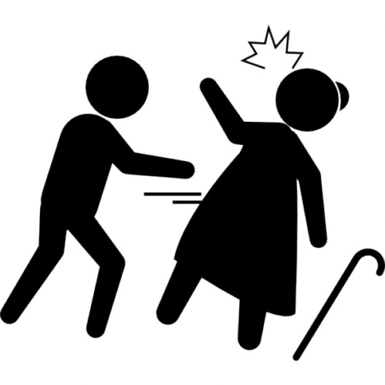
Types of Adult Abuse
Physical Abuse could include…
Hitting,
Pushing
locking them in a room
giving someone the wrong dose or wrong medication
forcible feeding

Slide 4
Signs of Physical Abuse can include…
Unexplained bruising, cuts, burns
Malnutrition (Someone who has malnutrition will loose a lot of weight),
unexplained falls,
Your carer doesn’t take you to your GP or the hospital if you have been hurt, or are not well
PLEASE NOTE:
These are some examples and others will apply

Slide 5
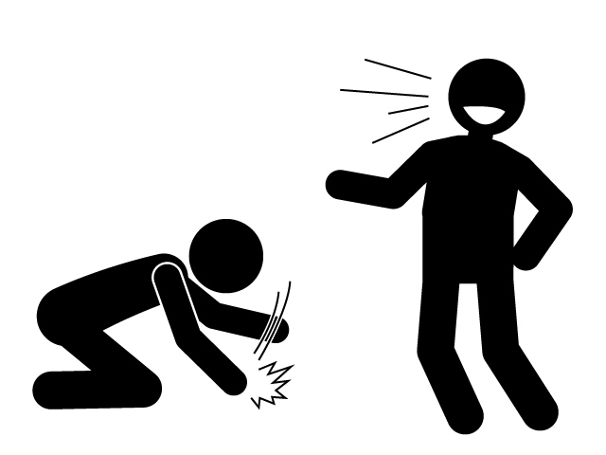
Emotional/Psychological Abuse could include…
Being picked on
Blaming
Harassing
Bullying
isolating someone

Slide 6
Signs of Emotional abuse can include…
Withdrawal
Change in mood,
Cannot sleep,
Low confidence,
Doesn't think they are capable of doing something,
A change of appetite,
weight loss/gain
PLEASE NOTE:
These are some examples and others will apply

Slide 7
Financial Abuse could include…
Stealing, something like
Money
Or
personal property such as jewellery etc.
Putting pressure on someone to change their Will to get something they want, like:
Inheritance
Or
property

Slide 8
Signs of Financial Abuse can include…
Missing personal possessions
unexplained withdrawal from bank accounts
unexplained lack of money
Carers or family having more money/new things than before
PLEASE NOTE:
These are some examples and others will apply

Slide 9
Sexual Abuse could include…
Rape
Sexual assault
When somebody touches you sexually when you don’t want them
Making you watch sexual videos when you don’t want to
This can happen to both women and men!

Slide 10
Sexual Abuse signs can include…
Bruises to inner thighs,
marks on neck,
difficulty in walking/sitting,
unusual bleeding to genitals or anus,
Sexual Transmitted Infections,
fear of receiving personal care support
Withdrawn
PLEASE NOTE:
These are some examples and others will apply

Slide 11
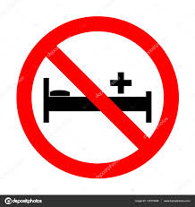
Neglect or Acts of Omission
Neglect is when someone says they are going to care for you but they do not. For example:
They do not provide you with food,
They don’t give you somewhere to sleep
The don’t give you the right clothing (such as a coat in winter)
The don’t let you have your heating on in winter so you are cold
They don’t give you the medication you need
They don’t take you to the doctor or hospital when you need medical help
Acts of omission is when someone sees you being abused, but doesn’t do anything about it.

Slide 12
Signs of Neglect or Acts of Omission can include…
Unclean home (when unpaid carers are supposed to clean the house)
Poor personal hygiene (when unpaid carers are supposed to help with this)
Pressure sores/ulcers
Untreated injuries or medical problems
Family or unpaid carers refusing visitors into the home
Inadequate clothing (e.g. no coat in winter)
Malnutrition or weight loss
PLEASE NOTE:
These are some examples and others will apply

Slide 13
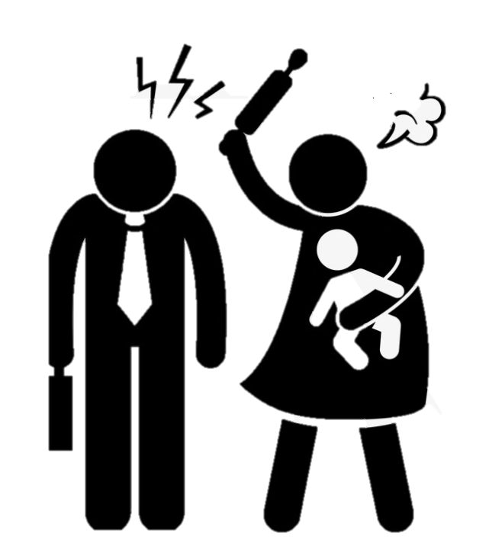
Domestic Abuse
When someone you are in a close relationship with (partner or family member) is
Physically violent
Mentally or emotionally hurts you
Shows controlling behaviour (decides things for you)
Notes:
Can anybody tell me what physical abuse can look like?
Can anybody tell me what emotional abuse is?

Slide 14
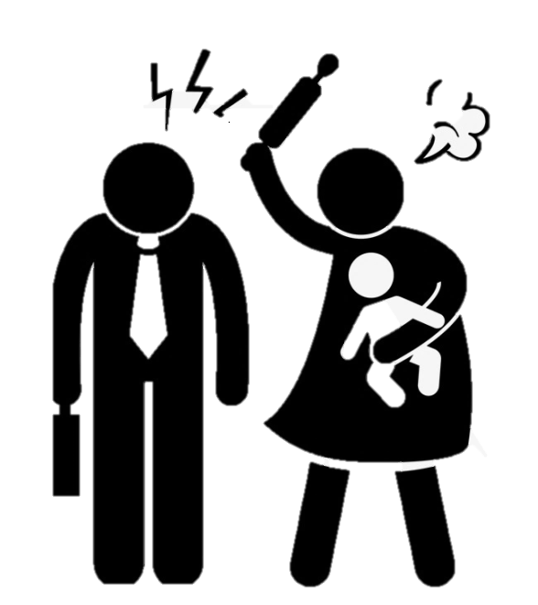
Signs of Domestic Abuse can include…
Low self-esteem,
verbal abuse or humiliation in front of someone,
isolation from family and friends
Physical signs
Bruising
Cuts
Broken bones
PLEASE NOTE:
These are some examples and others will apply

Slide 15
Self-Neglect
Self-neglect is when someone does not take care of themselves properly. This can put their safety, health and well-being in danger.
They may not…
Wash themselves
Eat
Clean their property
Hoard (collect things)

Slide 16
Signs of Self-Neglect can include…
Very poor hygiene
Messy/dirty appearances
Malnutrition (someone who has malnutrition will loose a lot of weight)
Hoarding (collecting lots of things) in their property
Living in filthy conditions
Lack of food and heating
Will not accept help from social care or health services
Will not let anyone into their home
PLEASE NOTE:
These are some examples and others will apply

Slide 17
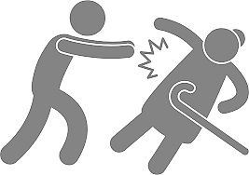
Organisational Abuse
Is any type of abuse that has been done by an organisation such as a care home, hospital, home care etc.
For example, a paid carer ignores you when you ask for a drink, or when you need to go to the toilet.

Slide 18
Signs of Organisational Abuse can include…
Not letting the person choose what they want to eat
Making the person go to bed early
Someone in hospital or a care home being hungry or dehydrated,
Lack of personal clothing and possessions,
Poor record-keeping and missing documents,
Unnecessary exposure during bath time or when using the toilet
PLEASE NOTE:
These are some examples and others will apply

Slide 19
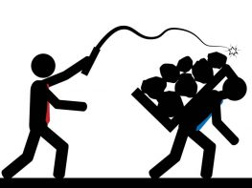
Modern Day Slavery can include…
Treating somebody like they are a slave
moving someone around the country/across border to use for:
sex trade
free/cheap labour in factories
Being treated like a maid
Criminal activities like pickpocketing or selling drugs

Slide 20
Signs of Modern Day Slavery can include…
Malnourished (very low in weight)
Filthy appearance
Withdrawn
Living in dirty, cramped or overcrowded accommodation
Living and working at the same address
Lack of personal possessions or identification documents
Always wearing the same clothes
Fear of Police
PLEASE NOTE:
These are some examples and others will apply

Slide 21
Forced Marriage and Honour Based Violence Forced Marriage is when someone is forced into getting married against their will. This can be one or both of the people who are getting married.
Honour Based Violence is a form of domestic
abuse, and is when someone is punished for
bringing ‘shame’ on their family. This can
be physical abuse, sexual abuse, emotional
abuse, or controlling behaviour.

Slide 22
Signs of Forced Marriage and Honour Based Violence can include…
Someone is going on a long holiday to the country of their origin
Their siblings have been ‘married off’ and not returned home
Absence from education (college or university) or work
The person being accused for being ‘too westernised’
Restrictions on leaving house including being ‘escorted’ everywhere.
PLEASE NOTE:
These are some examples and others will apply

Slide 23
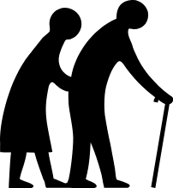
Discriminatory Abuse
Being treated badly because you are a different:
Race
Culture
Gender
Age
Disability
Sexuality

Slide 24
Who is at risk?
Someone over 18 years old who…
has care and support needs
For example:
Physical disability
Mental Health Issues
Cannot see or hear
Elderly
Unpaid carer looking after friends or family
may be experiencing or at risk of abuse or neglect
is unable to protect themselves from abuse and neglect because of their care and support needs

Slide 25
Who can abuse?
Partner/Husband/Wife
Family member
Carer
Friend
Stranger
Neighbour
An organisation
A Volunteer
Another service user
Abuse can be committed by anyone!
Notes:
Does anybody know?

Slide 26
Where can abuse occur?
On the street
At home
In a hospital
In a pub or club
On the bus or train
In a care home
Abuse can happen anywhere!

Slide 27
Did you know abuse is a Safeguarding issue?
What does safeguarding mean?
Safeguarding means protecting an adult’s right to live in safety, free from abuse and neglect.
Notes:
Can anybody tell me what safeguarding means?

Slide 28
How to report abuse
Ring…
Gateway to Care - 01422 393000 (day time)
Emergency Duty Team - 01422 288000 (Evenings and Weekends)
In an emergency call the Police – 999
Police non-emergency line - 101
Do this as soon as possible and make sure the person is safe!

Slide 29
What will happen after you report the concern?
After someone has reported concerns to Gateway to Care
A professional will decide on what needs to happen to make you safe
This will include speaking to you about what YOU want to happen - this is called Making Safeguarding Personal

Slide 30
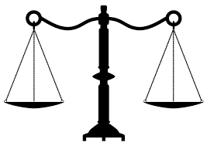
Making Safeguarding Personal (MSP)
Making Safeguarding Personal means listening to the views, wishes, and feelings of the Adult at Risk. These are known as ‘Desired Outcomes’.
It is supporting the Adult at Risk in making their own choices to protect themselves and keeping them safe.
Have you spoken to the person?
What do they want to happen?
This will depend on whether the adult can make that decision…

Slide 31
Mental Capacity
Mental Capacity means being able to make your own decisions.
We should always think of other ways we can ask a question to help the person understand what you are asking them. If you said it in a simpler way or used visual aids they might understand better.

Slide 32
Mental capacity can be different depending on:
WHAT THE DECISION IS ABOUT
For example:
Someone might be able to make a decision about what they want to eat from a burger, a pizza or salad.
But they might not be able to make a decision on where they live. They might want to live on their own, but cannot look after themselves so might need to live in a care home or supported living.
Notes:
What does decision specific mean?
What does time specific mean?

Slide 33
Mental capacity can also be different:
OVER TIME
For example: Someone has had a head injury, and cannot remember anything they are told so cannot make a decision.
6 months later
They make a full recovery and now has no memory problems, so they can now make decisions again.
We should ALWAYS assume can make a decision unless proved otherwise.

Slide 34
Advocacy
The Adult at Risk is also allowed to an Advocate during the Safeguarding Process. Speak to the Safeguarding Co-ordinator who can arrange this for them.
What is An Advocate?
An Advocate will listen to the Adult at Risk and help them to say what they want, understand what is being said.
Who can be An Advocate?
An Advocate can be:
a family member,
a friend or
an Independent Mental Capacity Advocate (IMCA).

Slide 35
Other Useful Information
Sarah’s Law
www.womencentre.org.uk/calderdale-staying-safe
www.calderdale-safeguarding.co.uk

